Slide 1
CASHIER BILLING SYSTEM FOR A RESTAURANT
NATIONAL INSTITUTE OF BUSINESS MANAGEMENT
Diploma in Software Engineering 20.2
Programming Fundamentals CW2 Group project

Slide 2
GROUP MEMBERS
CODSE202F-001 - K. H. P. SENALANKARA
CODSE202F-008 - K. A. N. D. KUMARASINGHE
CODSE202F-040 - K. H. N. L. FERNANDO
CODSE202F-051 - T. M. L. M. WEERASINGHE
CODSE202F-053 - M. G. I. N. RUPASINGHE

Slide 3
START
IF
bill>=2000
No
B
DECLARE
price, menu, quantity, total, final_bill, paid_amount, balance, food_item
Yes
IF
2000<=bill<4000
Yes
final_bill=total-total*5/100
PROCESS
show menu
A
No
final_bill=total-total*10/100
INPUT
food_item, quantity
OUTPUT
Final_bill
PROCESS
total=total+food_item*quantity
INPUT
paid_amount
another food item
(Y,N)
Yes
balance=paid_amount-final-bill
OUTPUT
balance
another order
Yes
No
A
B
No
END

Slide 4
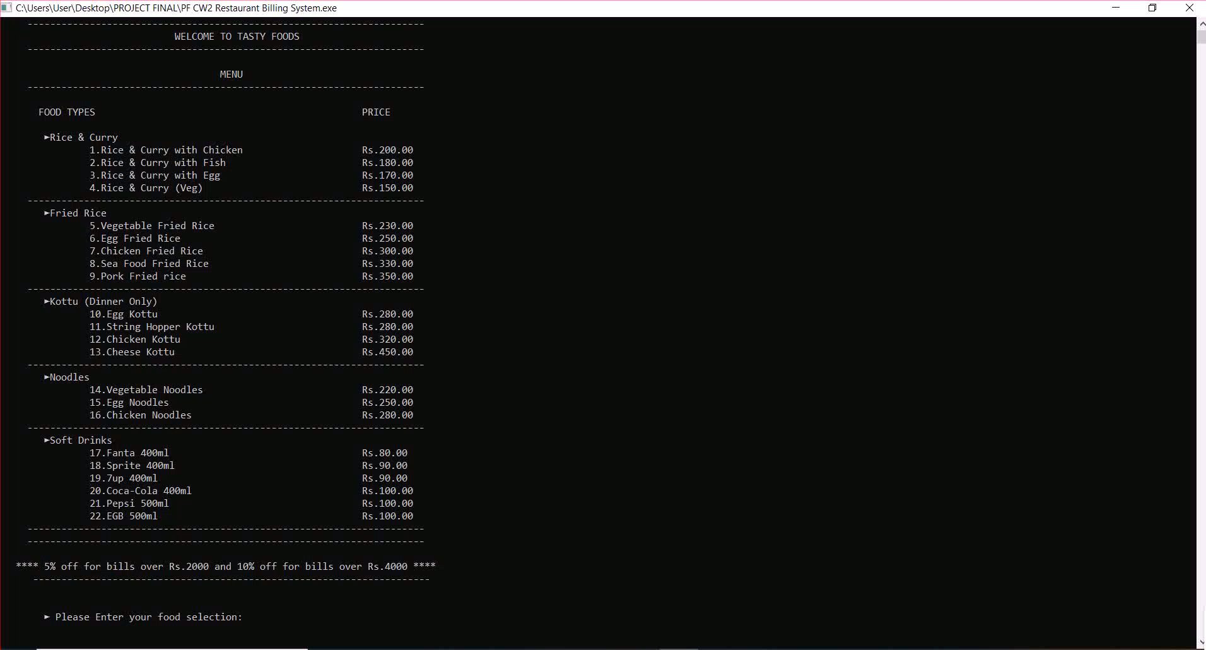

Slide 5
User Defined Functions Used:
The application of user defined functions and structures have been effectively used here. The user defined functions used in this C project are:
void menu()
void order()
void discountf()
Void bill_cal()

Slide 6
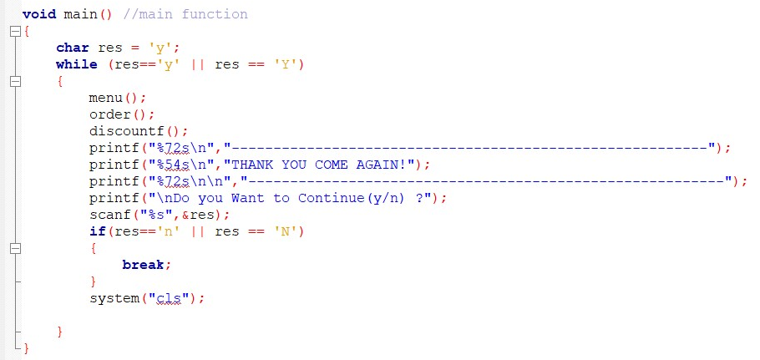
Main Function:
The function void main() is used to control all other sub functions.
In this function the system is asking from the user to continue or end.

Slide 7
void menu()
The function void menu() is used to show the food & drink items available in shop. There are 22 items with their prices and item code.

Slide 8
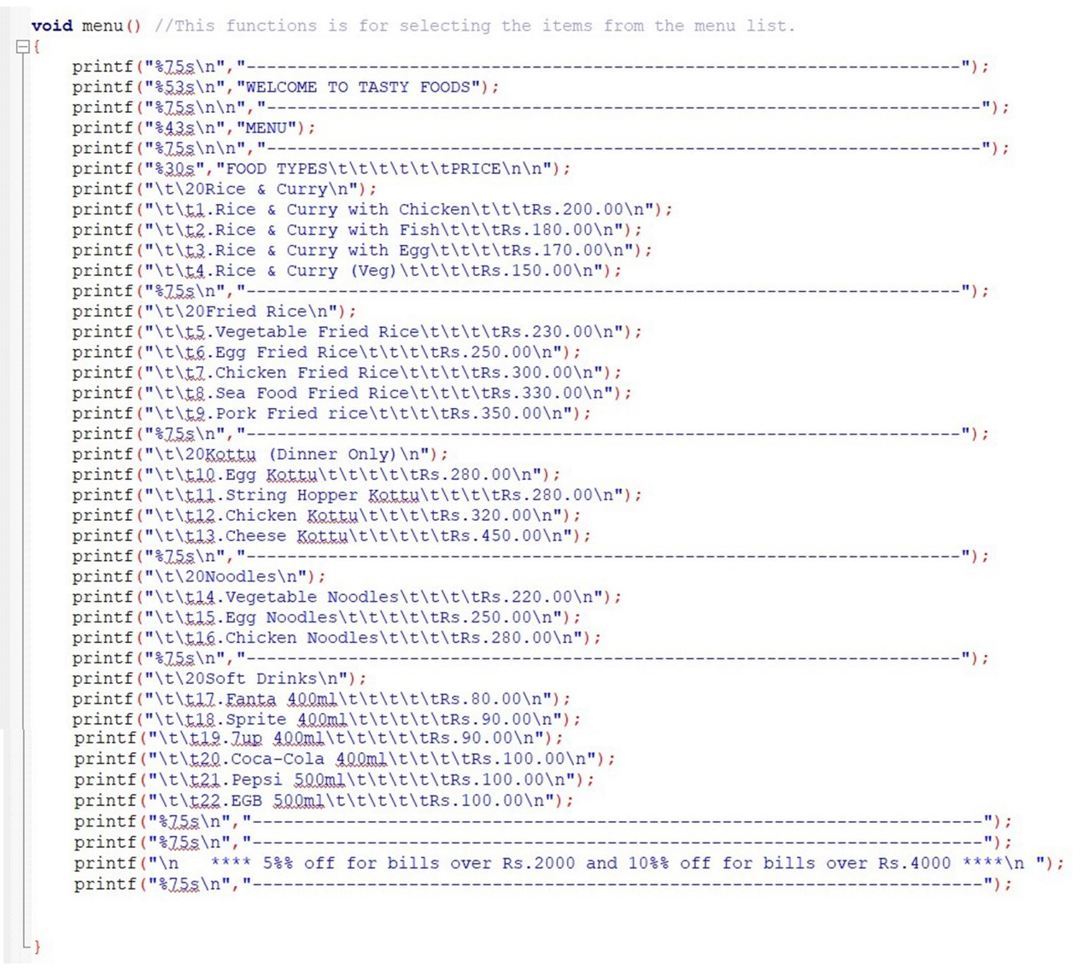

Slide 9
void order()
The function void order() is used to add food items and quantity according to the customer requirements. After taking the order it will calculate the sub total & display the bill structure with customer preferred items with the quantity. (Below are the steps for taking the order)
Steps:
1.Inserting the food item code as per the customer requirements.
2. Inserting the quantity of preferred food items.

Slide 10
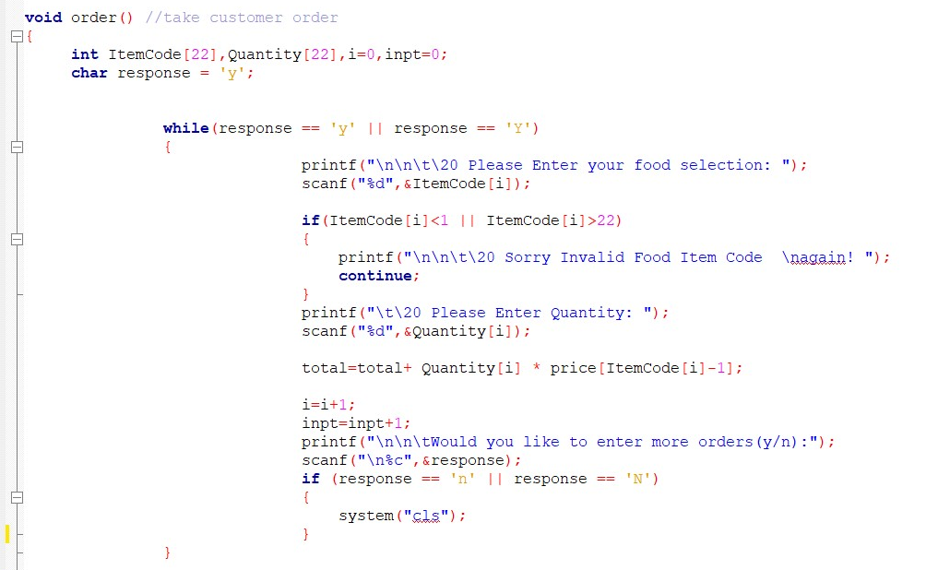
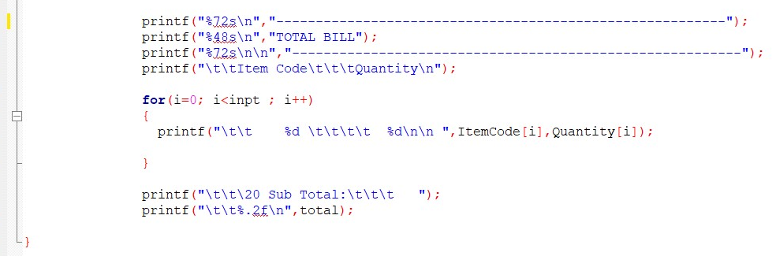

Slide 11
void discountf()
The function void discountf() is used to calculate the discount according to the sub total. We offer two type of discounts as shown below.
Rs. 2000.00 - 3999.00 5%
Rs. 4000.00 or Above 10%

Slide 12
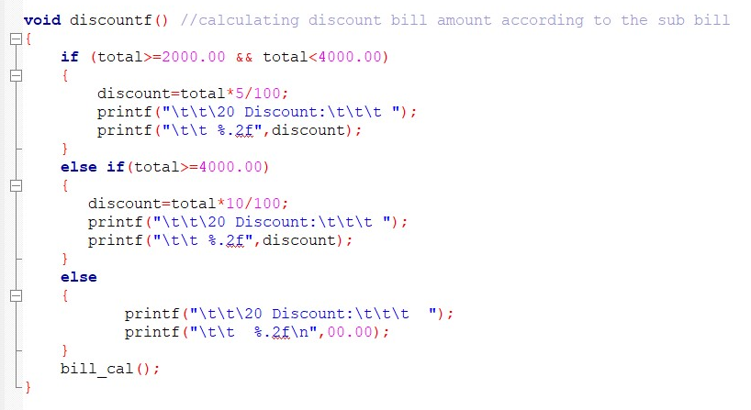

Slide 13
void bill_cal()
The function void bill_cal() is used to calculate the total due by subtracting the discount from sub total.
After calculating the total due the program will ask customer paid amount and show the balance amount as per the customer paid amount.

Slide 14
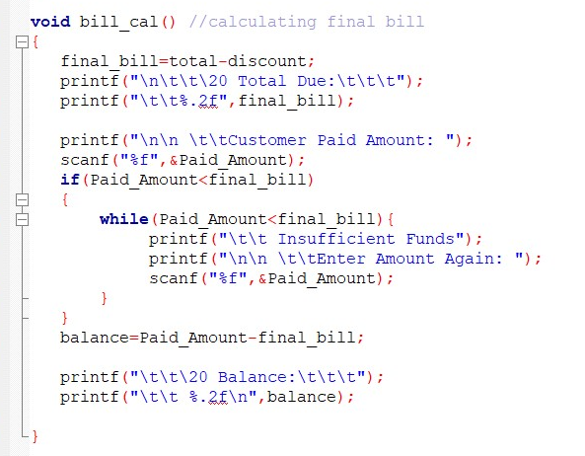

Slide 15


Slide 16
THANK YOU

